Slide 1
Problem Statement
Find out the data-driven ticket value based on the data we have of other resorts, so that we
can properly invest and compensate for the additional 1.5M additional operational cost
by the end of fiscal year 2021.
H
1
Context
4
Constraints within solution space
Big Mountain has been basing their prices on only market average; a data driven approach will reveal what a ticket should be valued as and help investment strategy without under/over valuing ticket price. Big Mountain Resort has recently installed an additional chair lift to increase the distribution of visitors across the mountain, increasing operating costs by $1,540,000 this season.
Time - finding the value before the next skiing season.
Features - some features are not present or intangible i.e. other resort amenities, typical snow quality, etc.
2
Criteria for success
5
Stakeholders to provide key insight
Have a collection of features that determines a profit-maximizing ticket value (or values, weekend and weekday, depending on market approach) by the end of fiscal year 2021.
Jimmy Blackburn - Director of Operations
Alesha Eisen - Database Manager
3
Scope of solution space
6
Key data sources
Focus will be on competitors in the shared market sector to determine ticket value. Further specificity to the number of lifts/t-bars/magic carpets, the length of the longest run, number of runs, the region, and elevation change as needed.
ticket value, the number of lifts, the number of t-bars, the number of magic carpets, the length of the longest run, number of runs, the region, and the elevation change.
H
D
E
I
P
Notes:
Hypothesis: Create a Hypothesis with an emphasis on SMART principles. (S – Specific, M – Measurable, A – Achievable, R – Realistic, T – Timebound). If you cannot do this, you do not have a good grasp on the business problem.
Context: With context, we have clearly identified the problem at hand and have elucidated on how our initiative may solve this problem, alongside the commercial implications this will have on the business.
Criteria for Success: Clearly defining the criteria for success ensures that the scope of your work is clearly defined and understood. Otherwise, if this isn’t defined – your work will never end which will result in mismatched expectations.
Scope of Solution Space: Scoping out the solution space ensures that the business initiative is SPECIFIC for a certain segment or area. This prevents solutions that have been developed being scaled and applied for all other business units that the solution may not be responsible or scalable for.
Constraints within Solution Space: Looking forward, what are the foreseeable problems we are likely to encounter? Could this be stakeholder resistance? Could this be we don’t have access to the right data?
Stakeholders to provide key insight: Who are the people I need to speak to, to get the answers I need for my data analysis?
What key data sources are required?
Based off my discussions with the key stakeholders – can we clearly list out all the data sources we need so we can make a highly targeted request as opposed to a scatter-gun approach where we ask for a bit of everything?

Slide 2
Recommendation and key findings
Currently, Big Mountain charges $81.00 for a weekend ticket. I recommend raising the price up to approximately $93.00.
I also recommend looking into closing down the least popular run.
Look into pushing that saved cost toward increasing vertical drop (that is, either increase the highest serviced point or lower the lowest point). It is unnecessary to increase the snow-covered acreage for this plan, as that would have no major effect on the ticket price and therefore no major effect on revenue.
Overall, the most important features, according to my models, are fast quads, number of runs, snow-making area, and vertical drop.

Slide 3
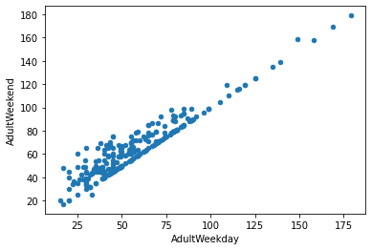
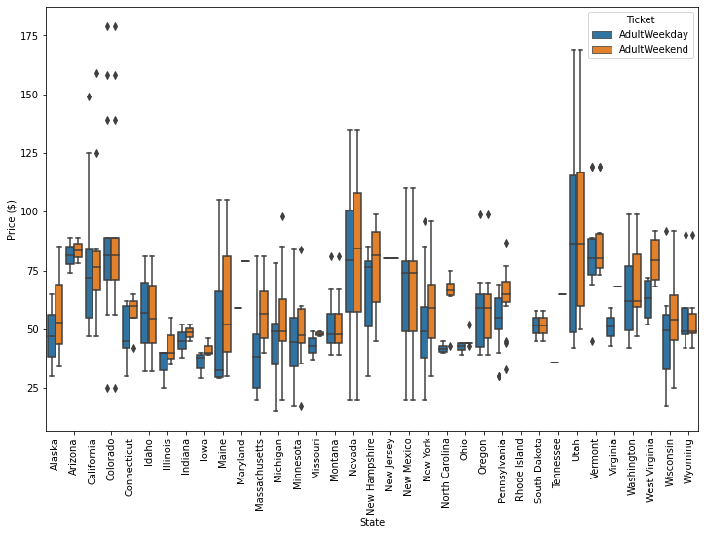
Modeling results and analysis
Prices were almost always more expensive for weekend prices than weekday prices; prices were identical in Montana.
To clean the data, we kept only columns with weekend prices - this is supported not only by the above, but also because we had more weekend price data.

Slide 4
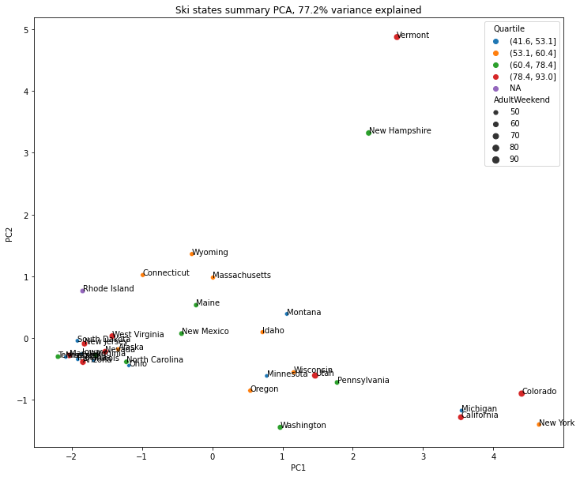
Modeling results and analysis (cont.)
Beginning with a principal component analysis, we found that there were no noticeable patterns in the top two features, even when examining state and size.

Slide 5
Modeling results and analysis (cont.)
The initial linear regression model performed well, accounting for over 80% of the variance on the train set and over 70% on the test set, though the large difference between our train and test sets suggests overfitting.
The top categories for the linear regression were, in order: vertical drop, snow-making area, total chairs, fast quads, number of runs, and longest run length.
In our random forest regressor model, the most important features were fast quads, number of runs, snow-making area, and vertical drop. The other features held less than 5% of the influence on ticket price; this is consistent with our linear model, with the top four of the random forest regressor model present in the top five of our linear model.
We based our recommendations on these four primary categories.

Slide 6
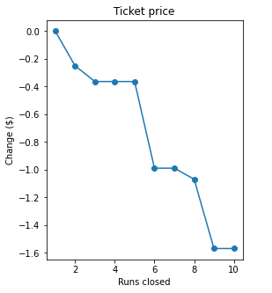
Modeling results and analysis (cont.)
Of the four options raised, closing down runs and increasing the vertical drop by adding a run without increasing snow-making coverage were supported best by my model.
Increasing snow-making coverage by 2 acres, as listed in the third option, does not have a significant influence on the ticket value, and therefore I recommend avoiding this extra cost.
Increasing the longest run by 0.2 miles also does not have a significant influence on the ticket value, as it is not one of our 4 most important features (fast quads, number of runs, snow-making area, and vertical drop). We also have the longest run in Montana and one of the longest in the country, so this small change would not be largely influential.

Slide 7
Summary and conclusion
Currently, Big Mountain charges $81.00 for a weekend ticket. I recommend raising the price up to approximately $93.00 and looking into
Closing down runs and increasing the vertical drop by adding a run, without spending extra time and money to increase snow-making coverage, were supported best by my model.
Overall, the most important features to raise ticket price, according to my models, are fast quads, number of runs, snow-making area, and vertical drop.
However, reducing our number of runs by one or two would likely increase overall revenue with lower maintenance cost. Additionally, increasing our snow-making area by only 0.2 acres is not worth the cost.

